Slide 1

Internet traffic prediction
PROJECT P-284
BY - PAYAL GHOSALKAR

Slide 2

Business Problem & Objectives
1
The problem
Internet traffic using a time-series forecasting technique to optimize resource allocation.
2
Objectives
Many real-world organizations, such as e-commerce retailers like Amazon, Ebay and others, use such applications to predict and monitor internet traffic. This project involves comparing the performance of the time - series prediction models designed of different approaches.

Slide 3
Dataset Details & Libraries Required
Libraries
We use python libraries such as Seaborn, Matplotlib, Pandas, Numpy, Stats models and Pickle to preprocess the dataset and train the model .
1
2
3
Source
Features
We are going to use a dataset comprises of 173 articles.
The dataset has two columns, one contains time series dates and other has number of visitors access internet on that date.

Slide 4
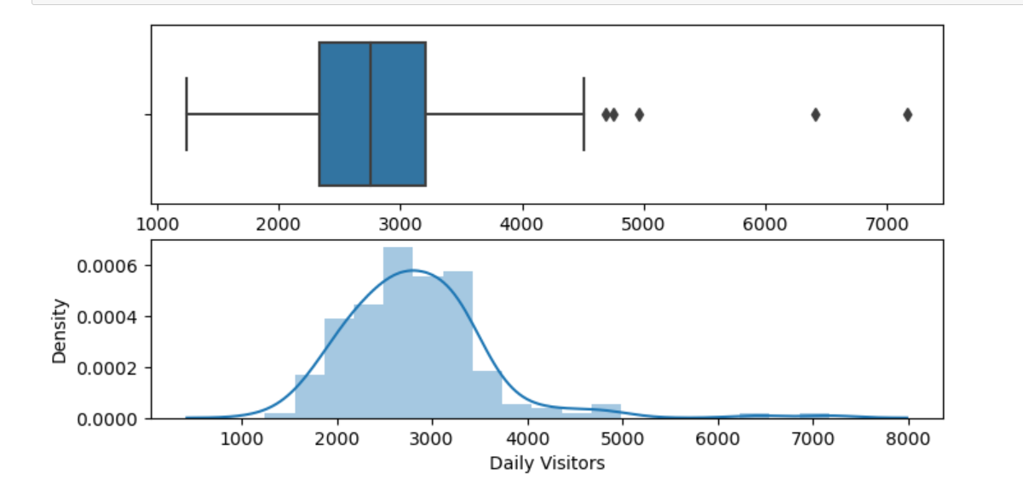
Exploratory Data Analysis & Visualization
Box plot to detect outliers :
Dataset is slightly positively skewed and has few outliers in it.
The most likely number of daily visitors is approximately 2,751.

Slide 5
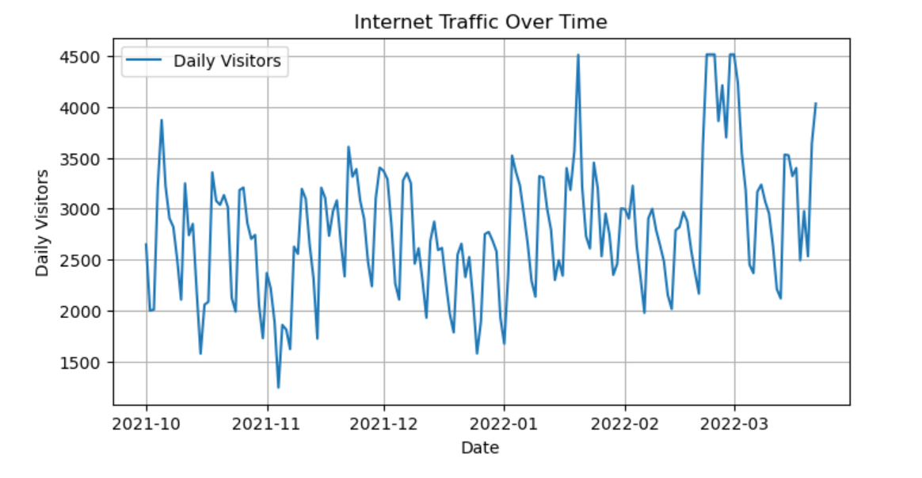
Internet traffic over time :
The data shows trend of daily visitors from October 2021 to March 2022.
In march 2022, visitor counts were higher than in other months

Slide 6
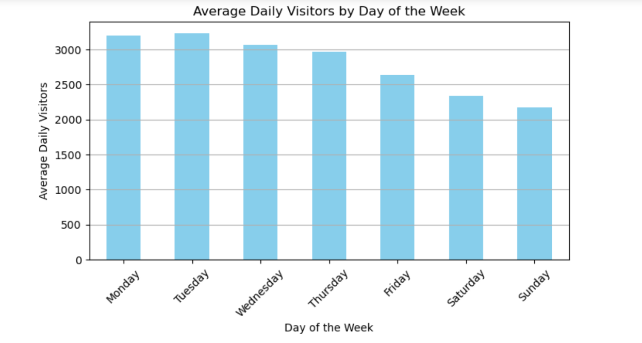
Average visitors by day :
Consistent visitors count observed across all weekdays.
Visitors count notably lower on weekends, indicating reduced activity compared to weekdays.

Slide 7
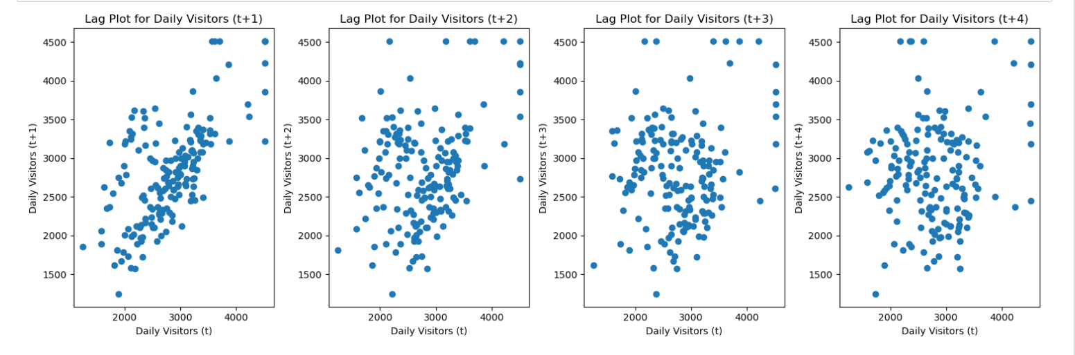
Lag plot for daily visitors:
Positive correlation in a lag plot up to lag 4 indicates that recent values strongly influence current data points.

Slide 8
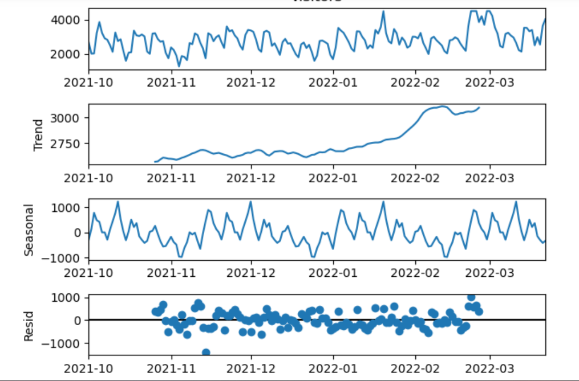
Seasonal Decomposition:
Seasonal decomposition highlights a change in the trend component specifically in March 2022, suggesting a significant event or shift in that period.
Residual components are present, indicating unexplained variation, also seasonality is evident in the decomposition.

Slide 9
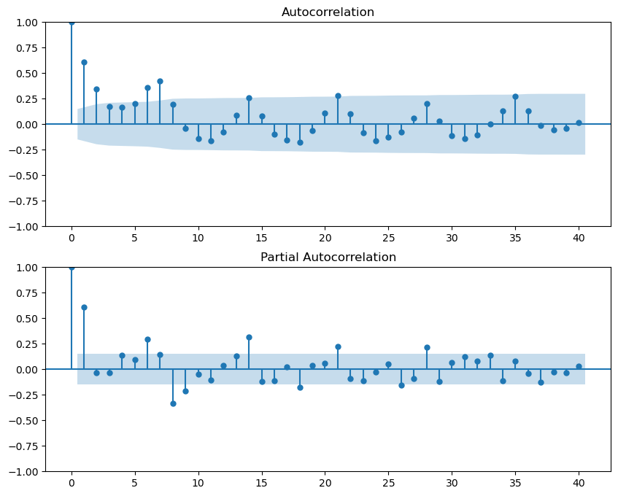
Autocorrelation Plot :
The autocorrelation function (ACF) plot revealing 5 points outside the confidence interval suggests that there are likely 5 significant lag values where the time series is correlated with its past values.
The partial autocorrelation function (PACF) plot showing 7 points outside the confidence interval indicates the presence of 7 significant lag values where the correlation with past values is not explained by intermediate lags.

Slide 10

Model Building
In our project we have built the model using below algorithms :
1. AR Model
2. ARIMA Model
3. SARIMA Model
4. LSTM
5. Exponential Smoothing

Slide 11
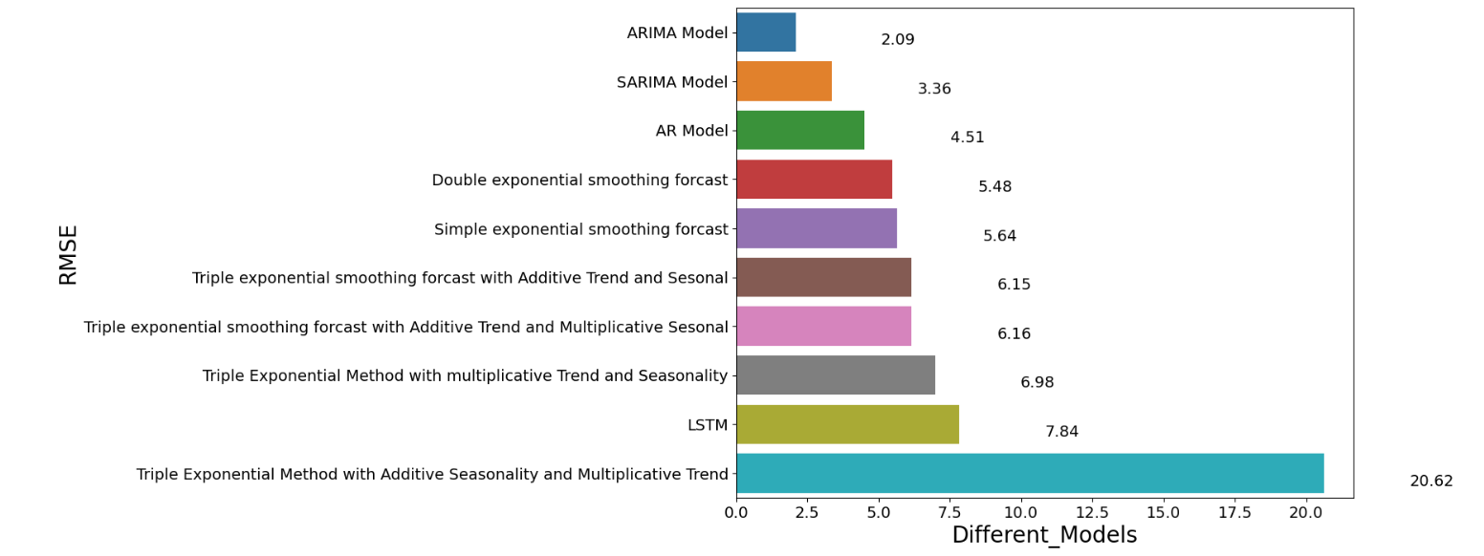
Model Evaluation
We have got the final model “ARIMA“ from the below plot with the least RMSE value of 2.09.

Slide 12
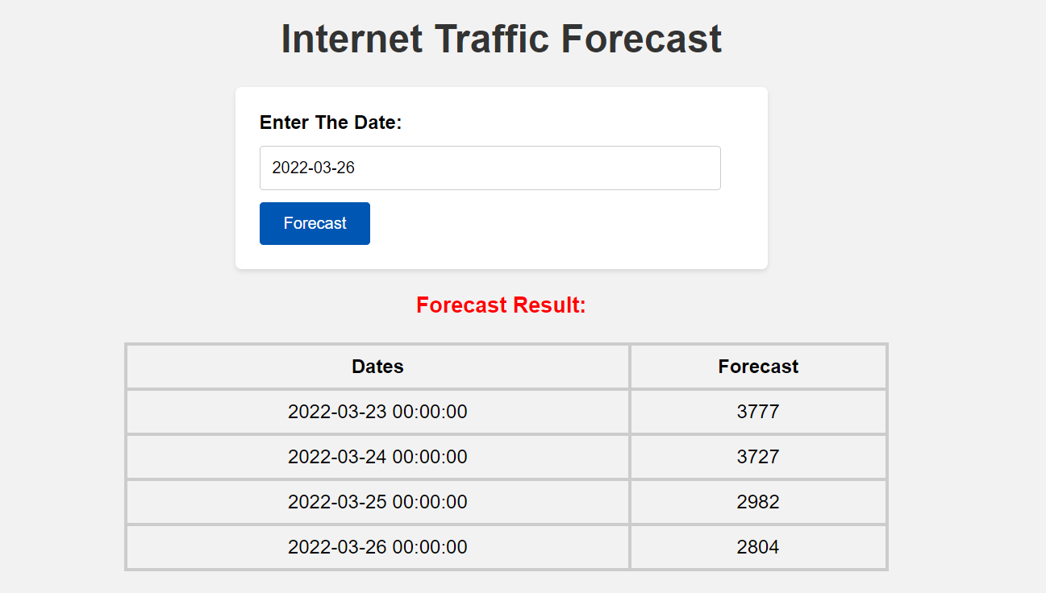
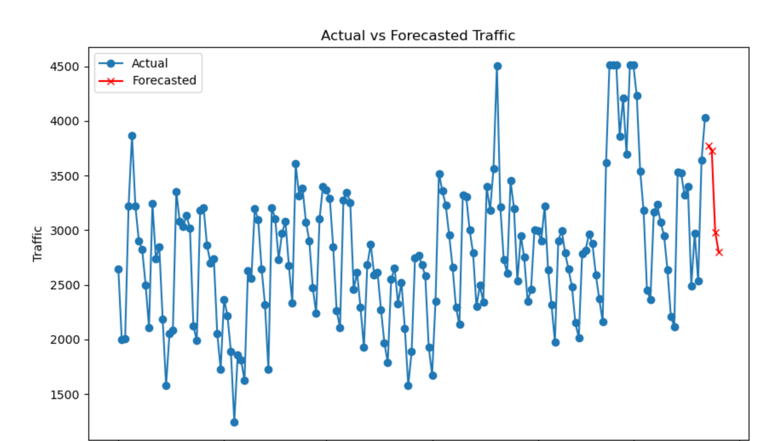
Model Deployment
Below is the interface for the model deployment.

Slide 13
Challenges Faced & Strategies to Overcome Challenges
Data patterns that repeat over time require transformation.
Identify and address unusual data points.
Choose the right ARIMA model order using criteria like AIC/BIC.
Clean, smooth, and fill in missing data for accuracy.
Evaluate model performance using time-based validation.
Adapt the model as network patterns change.
Optimize computation for efficiency.
Use parallel processing, specialized software, and hardware upgrades.
Require rigorous data prep, model selection, and adaptability for accurate internet traffic forecasting.
Implement robust time-based cross-validation to ensure model accuracy and reliability.
Continuously update the model to address evolving internet traffic patterns and conditions.
Engage domain experts to provide insights and domain-specific knowledge for more accurate forecasts.

